Slide 1
Course Recommender System
with Unsupervised Machine Learning
Bo-Yan Huang
2024 1/16

Slide 2
Introduction - Background
In the era of digital education, our project aims to transform the learning landscape through an advanced recommender system. The mission is to enhance user experiences by seamlessly connecting learners with new, relevant courses, shaping personalized educational paths.
This initiative not only strives to improve user satisfaction but also anticipates a positive impact on company revenue. By facilitating user engagement with diverse courses, we envision a symbiotic relationship between learner contentment and business growth.
Notes:
In the age of digital education, our project seeks to revolutionize the learning environment with a sophisticated recommender system. Our goal is to elevate user experiences by effortlessly linking learners to new, pertinent courses, thereby molding personalized educational journeys.
This endeavor not only aims to enhance user satisfaction but also foresees a favorable influence on company revenue. By fostering user engagement with a variety of courses, we envision a harmonious connection between learner contentment and business expansion.

Slide 3
Introduction - Challenges
Limited Course Discoverability: Users face challenges in discovering new and relevant courses that align with their interests and learning goals, leading to a suboptimal learning experience.
Underutilized Learning Paths: The absence of personalized recommendations may result in users not fully realizing the potential of a structured learning path, hindering their educational progression and engagement.
Revenue Growth Opportunities: The current lack of an effective recommender system may be limiting the company's revenue potential, as user interactions with courses could be suboptimal.

Slide 4
Introduction - Hypothesis
Relevance: Implementing a recommender system will significantly improve course recommendations, enhancing user satisfaction.
Engagement: The recommender system will boost user engagement, creating a more active and committed user base.
Learning Path Optimization: The system will optimize users' learning paths for a more effective educational journey.
Revenue Impact: Enhanced user engagement will positively affect company revenue by increasing enrollments and interactions.
Model Performance: In the Proof of Concept phase, exploring machine learning models aims to identify superior performance for effective online implementation.

Slide 5
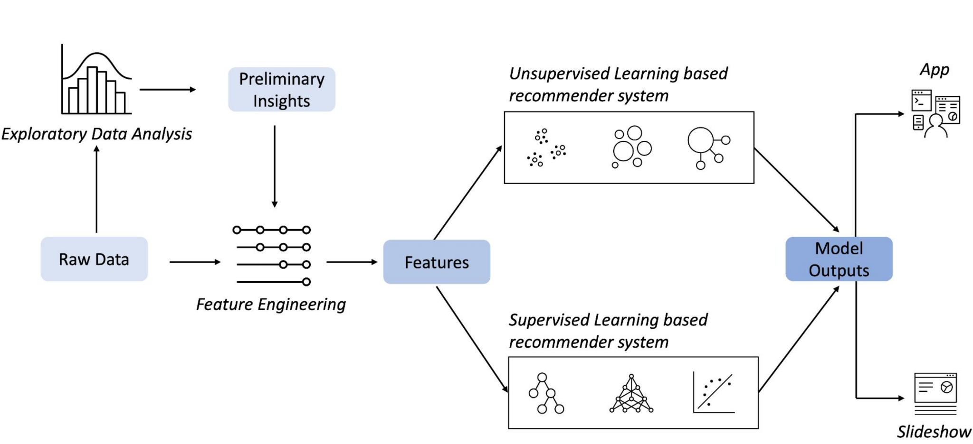
Machine Learning Workflow

Slide 6
Exploratory Data Analysis
Statistical Overview
Keyword Identification using WordCloud
Find Popular Course Genres
Summary Statistics and Visualizations for Enrollment Data

Slide 7
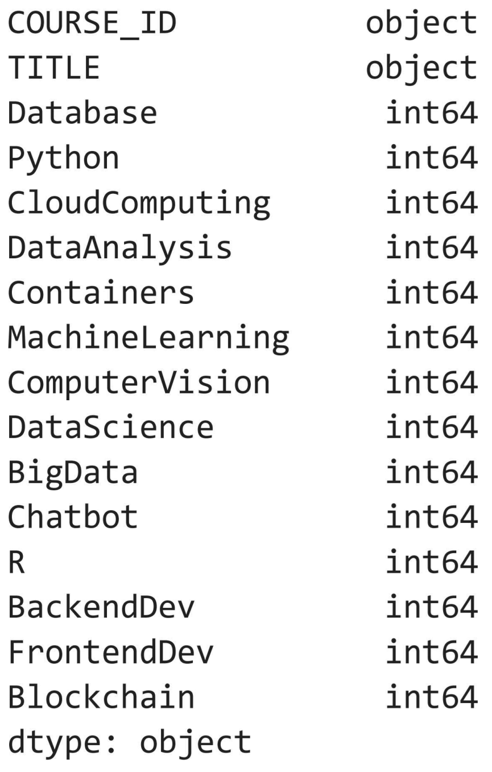
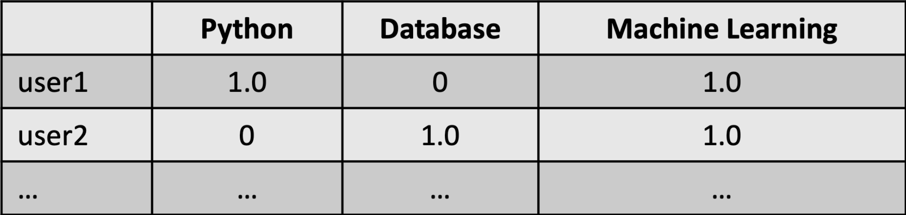
Columns/Features of the Data:
User profile vectors
Course dataframe columns

Slide 8
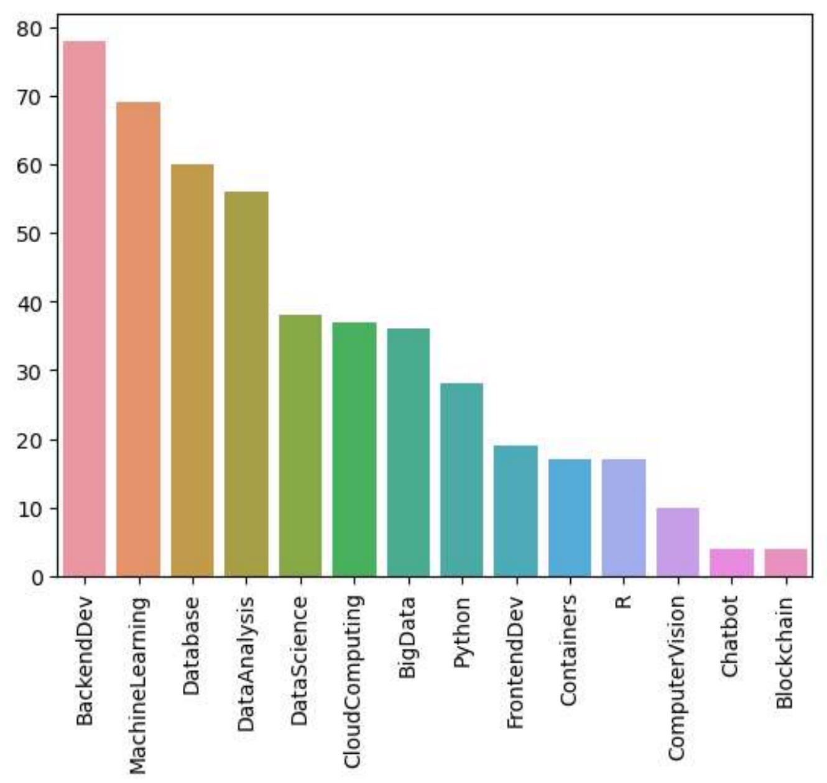
Course counts per genre
Backend Development, Machine Learning, and Database emerge as the most widely embraced genres. In contrast, Blockchain, Chatbot, and Computer Vision draw less attention."
Notes:
Backend Development, Machine Learning, and Database emerge as the most widely embraced genres, enjoying significant popularity. In contrast, Blockchain, Chatbot, and Computer Vision represent the less commonly explored niches within the dataset.

Slide 9
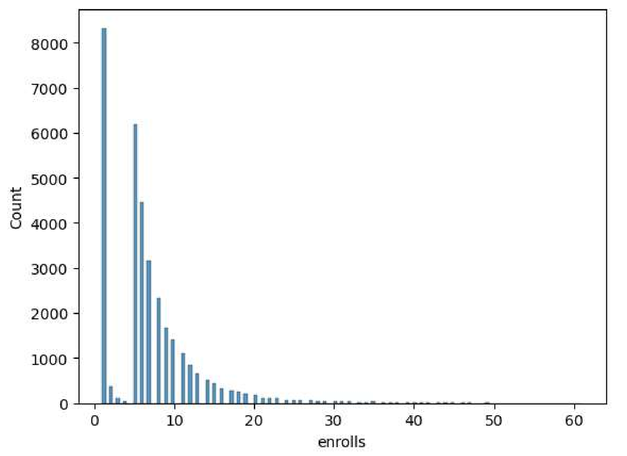
Course enrollment distribution
The provided histogram depicts the distribution of user rating counts. The majority of users either refrained from rating any courses or did so infrequently. However, a small number of exceptional students gave ratings for more than 40 courses.
Notes:
The provided histogram depicts the distribution of user rating counts. The majority of users either refrained from rating any courses or did so infrequently. However, a small number of exceptional students gave ratings for more than 40 courses.

Slide 10
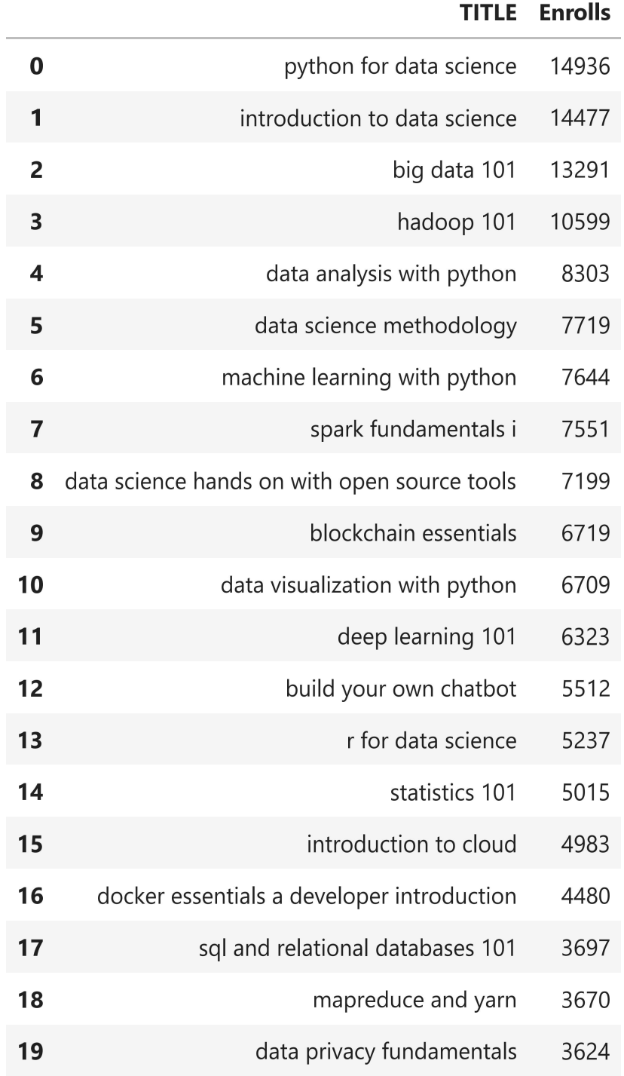
20 most popular courses
The table below displays the top 20 widely-adopted courses. Nine out of the top 10 courses pertain to the data topic, with the 4th course being the sole representative of the software engineering topic.
Notes:
Backend Development, Machine Learning, and Database emerge as the most widely embraced genres, enjoying significant popularity. In contrast, Blockchain, Chatbot, and Computer Vision represent the less commonly explored niches within the dataset.

Slide 11
Flowchart of clustering-based recommender system
User/Item feature engineering
Recommend courses
Raw data
Group users
Course genres dataframe:
course_id, title, [genre_x, genre_y,...]
User dataframe:
user_id, [genre_interest_x, genre_interest_y,...]
Extract features from users such as enrollments or genres
Apply PCA on user profile feature vectors to reduce dimensions
Divide users into several groups based on their enrollments or genres
Recommend popular courses according to the preferences of other users within the same group.
Notes:
Now we divided users into several groups based on their enrollments.

Slide 12
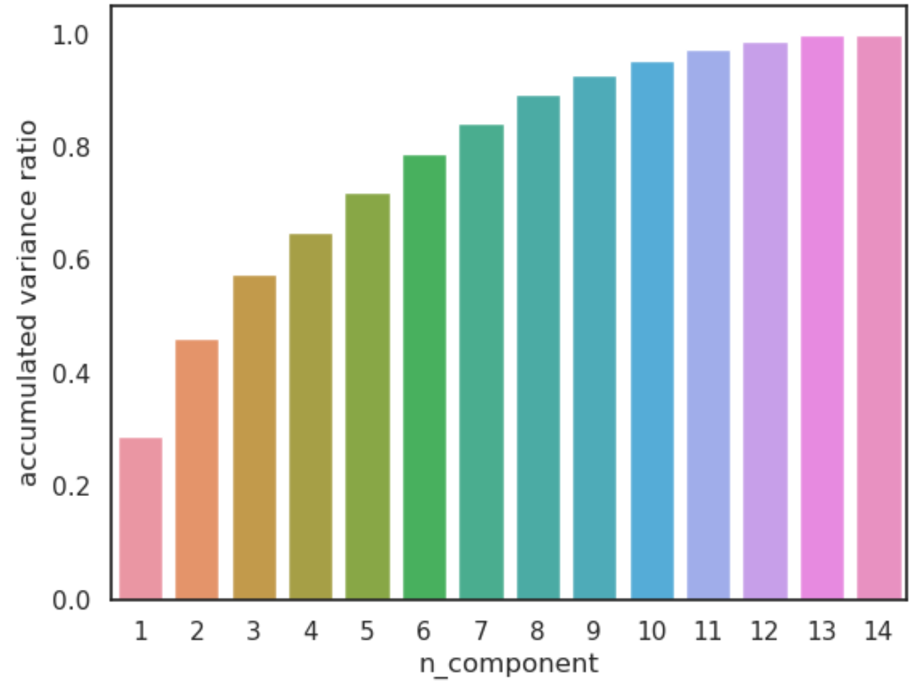
Flowchart of clustering-based recommender system
User/Item feature engineering
Extract features from users such as enrollments or genres
Apply PCA on user profile feature vectors to reduce dimensions
Notes:
If we plot a covariance matrix of the user profile feature vectors with 14 features, we can observe that some features are actually correlated.
For example it is obvious that the feature MachineLearning and the feature DataScience are correlated.
Such covariances among features may indicate that we can apply PCA to find its main components (eigenvectors with max eigenvalues on the covariance matrix).
If we only keep the independent main components, then we can reduce the dimensions of our user profile feature vectors.
If the accumulated variances ratio of a candidate n_components is larger than a threshold, e.g., 90%, then we can say the transformed n_components could explain about 90% of variances of the original data variance and can be considered as an optimized components size.

Slide 13
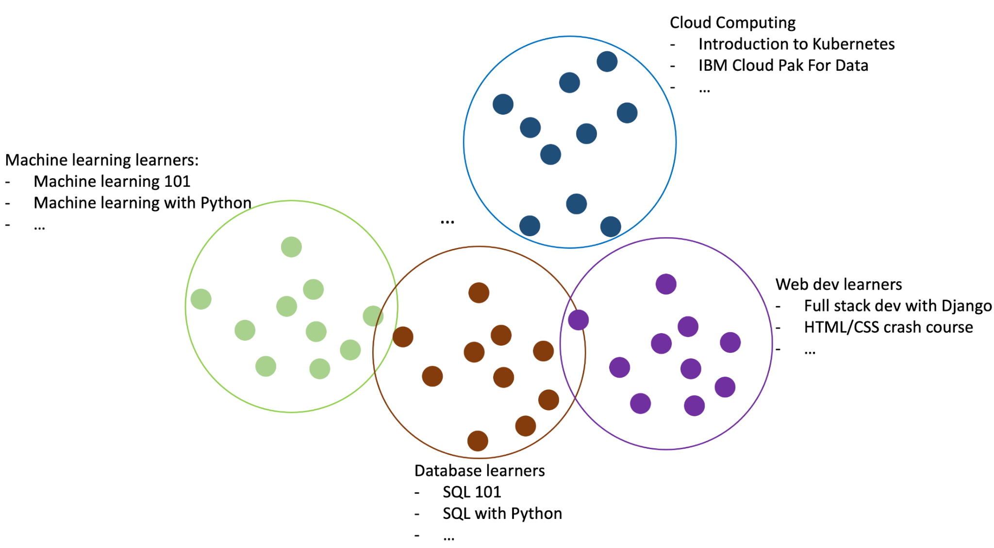
Flowchart of clustering-based recommender system
Group users
Divide users into several groups based on their enrollments or genres
Notes:
For each user group, we can come up with a list of popular courses. For example, for the machine learning user cluster/learning group, we can count the most frequently enrolled courses, which are very likely to be the most popular and good machine learning courses because they are enrolled by many users who are interested in machine learning.
If we know a user belongs to the machine learning group, we may recommend the most enrolled courses to them and it is very likely the user will be interested in them.

Slide 14
Comparing Clustering Approaches
Method name | K-means | Mean-shift | Hierarchical clustering | DBSCAN
Parameters | Number of clusters | Bandwidth | Number of clusters | Neighborhood Size
Scalability | Very large n_samples medium n_clusters with MiniBatch code | Not scalable with n_samples | Large n_samples and n_clusters | Very large n_samples, medium n_clusters
General use Case | General purpose even cluster size, flat geometry, not too many clusters | Many clusters, uneven cluster size, non-flat geometry | Many clusters, possibly connectivity constraints | Non-flat geometry, uneven cluster sizes, outlier detection
Applications | Find few clusters of roughly the same size | Can identify number of clusters, often used in video | Clusters may be of different size, does not identify outliers | Often used in computer vision applications
Notes:
We anticipate the course recommender to be scalable with a moderate number of clusters and even cluster sizes. Algorithms meeting these criteria include K-means and DBSCAN.

Slide 15
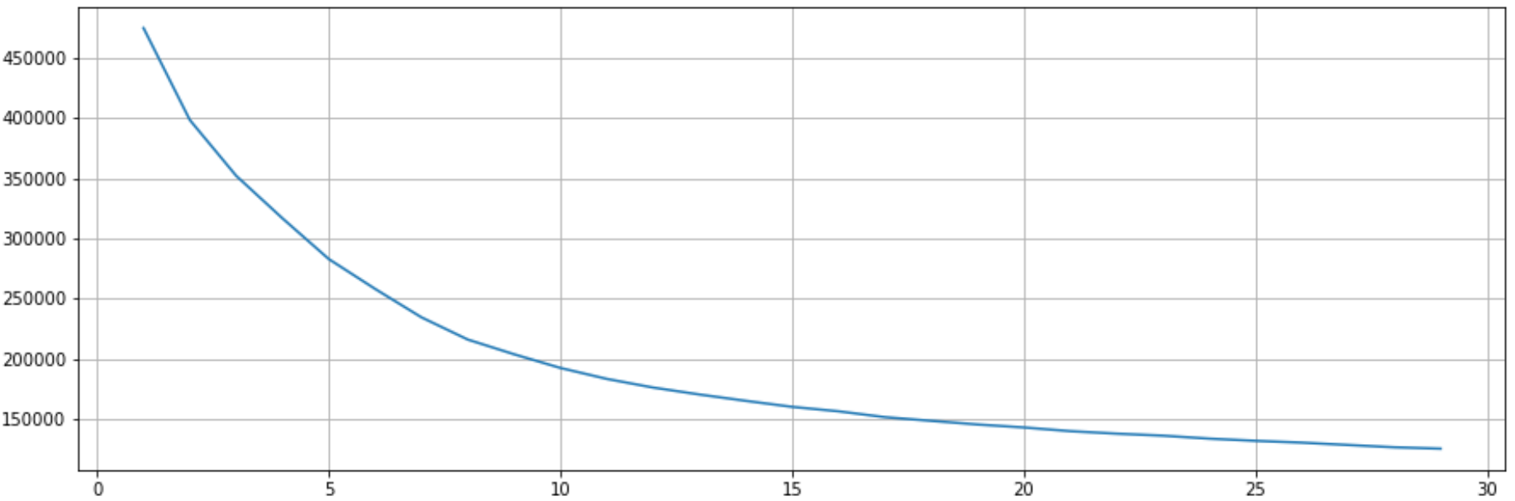
K-means
Inertia curve
Sum of squared distance
Number of cluster k
Notes:
For KMeans algorithm, one important hyperparameter is the number of clusters n_cluster, and a good way to find the optimized n_cluster is using to grid search a list of candidates and find the one with the best or optimized clustering evaluation metrics such as minimal sum of squared distance (Inertia)
From the elbow plot, we can visualy identify the point where the metric starting to be flatten, which indicates the optimized number of clusters.
In this case, the optimized number is 30.

Slide 16
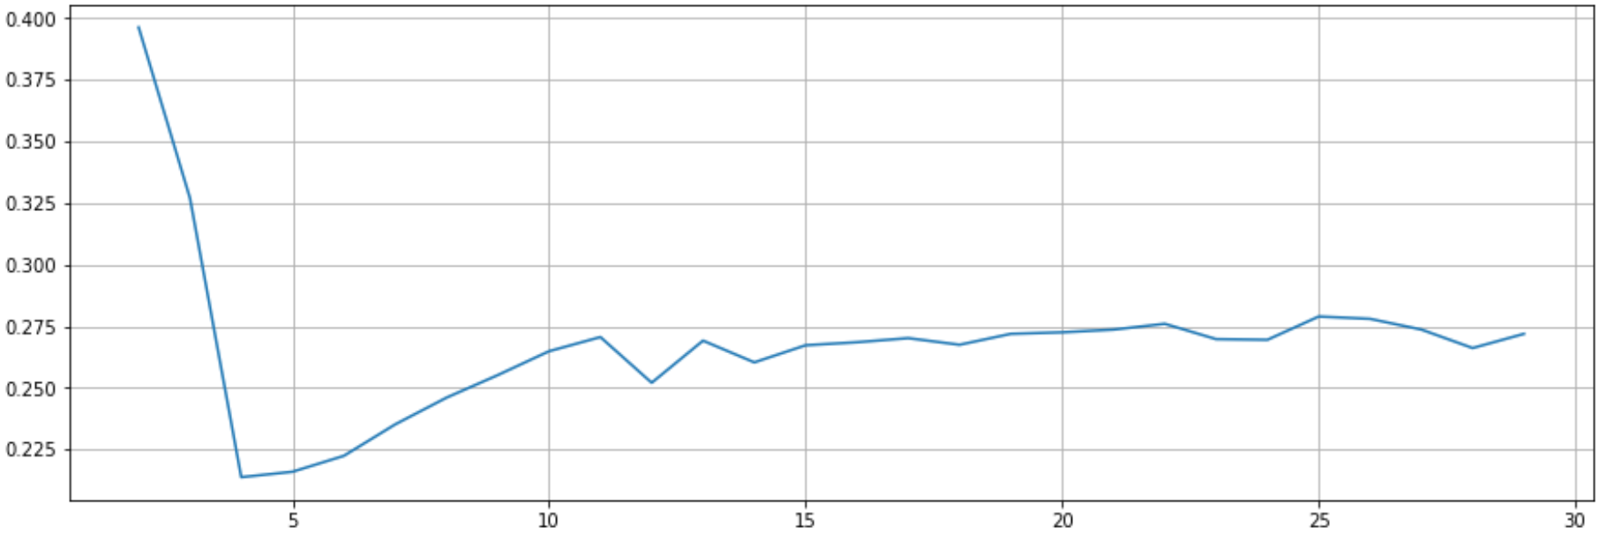
K-means
Silhouette score curve
Silhouette score
Number of cluster k
Notes:
Another widely used metric is the Silhouette score, employed to assess the quality of clustering results in data clustering. This score is computed by evaluating each data point's similarity to its assigned cluster and dissimilarity from other clusters.
A higher Silhouette score indicates better clustering. Given our preference for a moderate number of clusters, we concentrate on the range 5 < k < 100. As observed earlier, 30 proves to be a suitable choice.

Slide 17
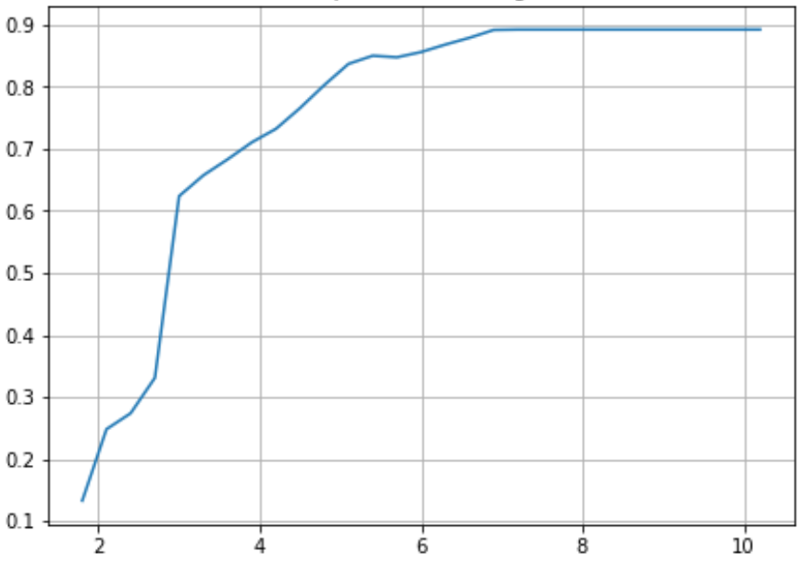
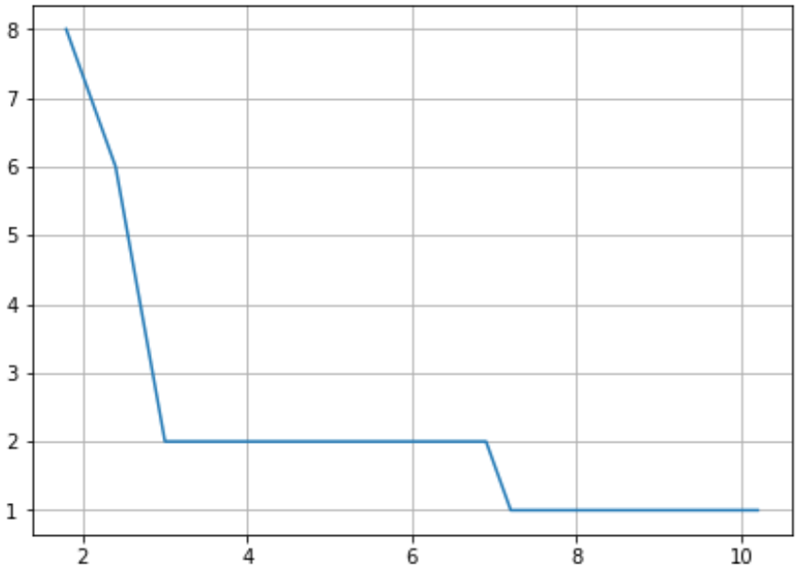
DBSCAN
Silhouette score curve
Silhouette score curve
Silhouette score
Silhouette score
Neighborhood size(epsilon)
Neighborhood size(epsilon)
Notes:
A higher Silhouette score signifies improved clustering. Nonetheless, a significant increase in epsilon drastically reduces the number of clusters identified. We focus on the range 5 < k < 100, and consequently, DBSCAN does not meet our criteria.

Slide 18
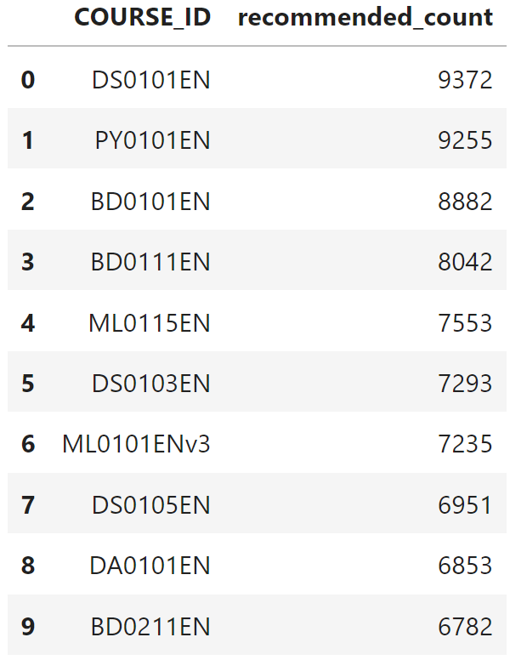
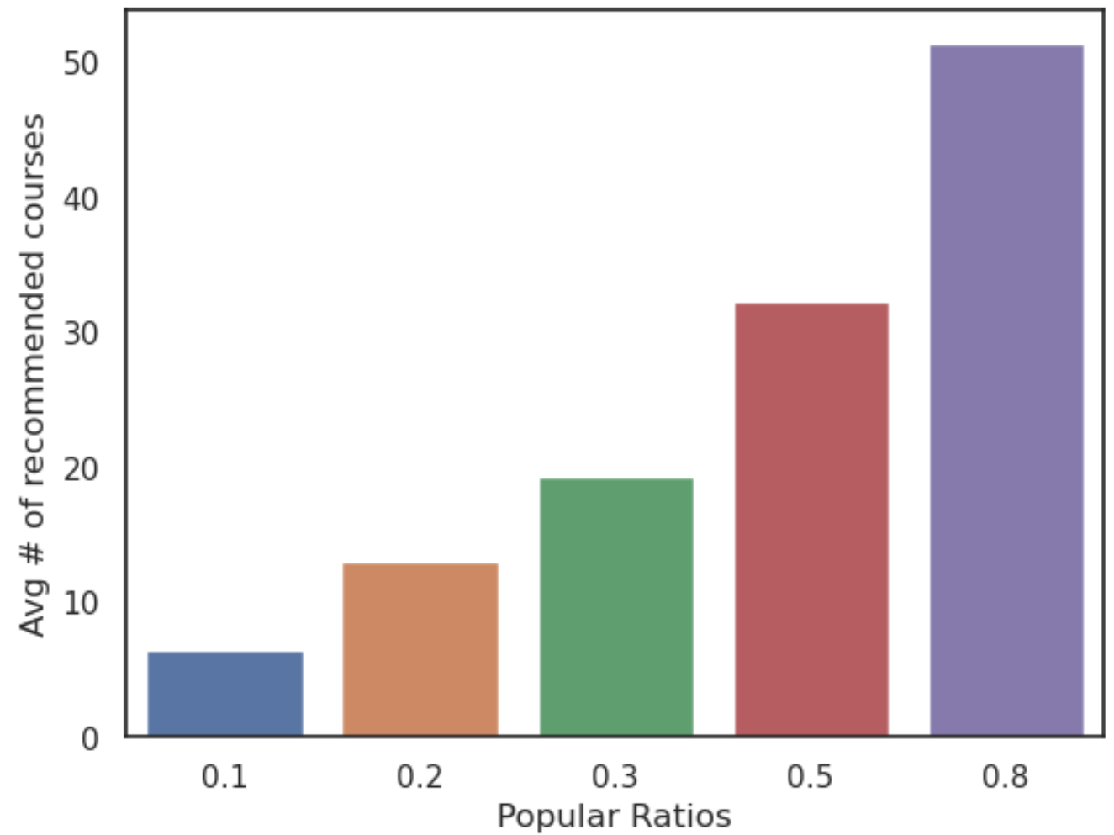
Evaluation results of clustering-based recommender system
In the lower left chart, we adjust the popular ratio range from 0.1 to 0.8, while keeping PCA features at 9 and n_clusters at 30 for the KNN classifier. To achieve around 10 recommended courses per user, we specifically set the popular ratio to 0.2. The popular ratio is defined as the ratio of all enrollments within the user's cluster.
Notes:
The lower left plot displays the average number of new or unseen courses recommended per user in the test dataset (~10000 samples). Meanwhile, the lower right plot illustrates the top-10 commonly recommended courses.
In the lower left chart, we vary the threshold range from 0.1 to 0.8, maintaining the PCA features at 9 and n_clusters at 30. To attain approximately 10 recommended courses per user, we set the popular ratio to 0.2. The popular ratio is defined as the ratio of all enrollments within the cluster to which the user belongs.

Slide 19
Conclusions
We can group users based on the genre in their profiles and suggest courses that are popular within the same cluster
Applying PCA to user profile feature vectors can decrease dimensions, consequently reducing computational power requirements
The K-means method is preferred for our project.
We have the flexibility to fine-tune the number of recommended courses by adjusting the popular ratio parameter.

Slide 20
Outlook
Possible issues:
Cluster Interpretability: Understanding and interpreting the meaning of clusters can be difficult. Without clear domain knowledge, it might be challenging to explain why certain items or users are grouped together.
Dynamic Nature of Data: User preferences and item popularity can change over time. Unsupervised models might struggle to adapt to dynamic shifts in user behavior and preferences.
Lack of Personalization: Traditional clustering methods might not capture individual user preferences well, leading to less personalized recommendations.
Evaluation Metrics: Selecting appropriate evaluation metrics for unsupervised recommendation systems is challenging. Defining what constitutes a "good" clustering can be subjective.

Slide 21
Outlook
Possible solutions:
Cluster Interpretability: Gather user-generated course ratings and construct an interpretable supervised machine learning model, such as a decision tree, to elucidate the characteristics of the identified clusters
Dynamic Nature of Data: Periodically retrain the model with updated data to adapt to changes in user preferences and item popularity over time
Lack of Personalization: Combine clustering with user-specific features or collaborative filtering methods to enhance the personalization of recommendations
Evaluation Metrics: Define and use appropriate evaluation metrics based on the specific goals of the recommendation system. Incorporate user feedback and conduct A/B testing to assess the real-world impact of recommendations

Slide 22
Appendix
Data source: https://cf-courses-data.s3.us.cloud-object-storage.appdomain.cloud/IBM-ML321EN-SkillsNetwork/labs/datasets/user_profile.csv
Courses:
https://www.coursera.org/learn/ibm-unsupervised-machine-learning/home
Jupyter notebooks:
https://github.com/r95222023/IBM-Machine-Learning-Professional-Certificate/tree/main/Unsupervised%20Machine%20Learning

